Slide 1
E-commerce Product Delivery Prediction
By- Shruti Kolhe
Data Science And Artificial Intelligence
YRWD-JUN2024-DSAI-2
Mentor: Pankaj Kumar Vishwakarma

Slide 2
Agenda
Introduction
Objective
Scope of the Project
Project Planning
Importing Libraries
Dataset Overview
Data Cleaning
Exploratory Data Analysis
Data Preprocessing
Model Selection
Evaluation Metrics
Model Comparision
Results and Insights
Model Deployment
User Interface
Conclusion

Slide 3

Introduction
Title: E-Commerce Product Delivery Prediction Using Machine Learning
E-commerce growth has increased demand for faster, more reliable delivery services.
Delivery delays can negatively impact customer experience and business reputation.
Traditional delivery systems often lack predictive capabilities to accurately estimate delivery times.
Machine learning and AI can help predict delivery outcomes based on various influencing factors.

Slide 4




Objectives
Develop machine learning models to predict product delivery timeliness.
Build predictive models to determine on-time delivery probability.
Understand customer preferences and behavior patterns related to delivery.
01
02
04
03
Study key factors affecting delivery performance.
Analyze factors influencing delivery times and customer behavior.

Slide 5






Scope of the Project
Predictive Analytics
Customer
Satisfaction
Scope of the Project
Real-Time Monitoring
Data Integration
Optimization
Scalability

Slide 6






Project Planning
Project Definition and Planning
Feature Engineering
Model Evaluation and Testing
User Interface
Deployment and Maintenance
Model Development
Data Collection and Preprocessing

Slide 7





Importing Libraries
Data Collection and manipulation: Numpy and Pandas
Data Visualization: Seaborn and Matplotlib
Machine Learning Model : Logistic Regression, Decision Trees, Random Forest Regressor, Support Vector Classifier, XG Boost
Preprocessing and Feature Engineering
Model Evaluation Libraries (sklearn.metrics): accuracy score, precision score, recall score, f1_score, confusion matrix, classification report, roc_auc_score

Slide 8
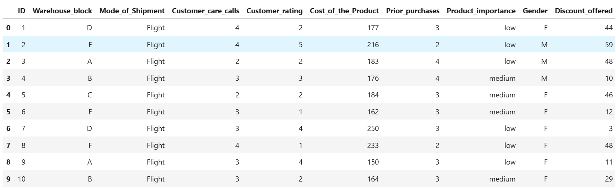
Dataset Overview
Dataset Link: https://drive.google.com/file/d/1FH4vy1C7pWkRoCPVICkam18Z9h9790o4/view?usp=sharing

Slide 9


Dataset Overview
ID: Unique identifier for each customer.
Warehouse Block: Divisions of the warehouse into blocks (A, B, C, D, E).
Mode of Shipment: Shipping methods include Ship, Flight, and Road.
Customer Care Calls: Number of customer inquiries related to the shipment.
Customer Rating: Ratings given by customers (1 - Worst, 5 - Best).
Cost of the Product: Price of the product in US Dollars.
Prior Purchases: Number of previous purchases by the customer.
Product Importance: Categorization of products (Low, Medium, High).
Reached on Time (Target Variable): Indicates delivery status (1 = Late, 0 = OnTime).

Slide 10
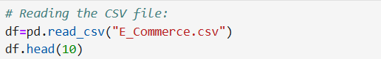
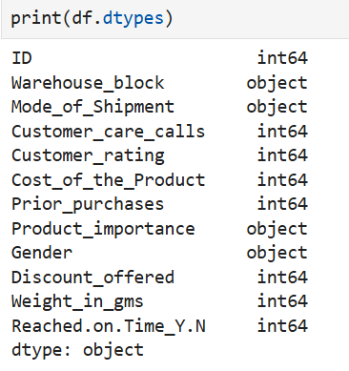
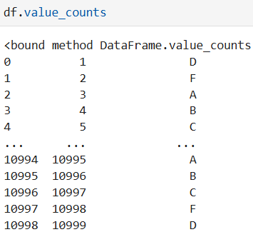
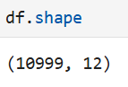
Dataset Overview

Slide 11
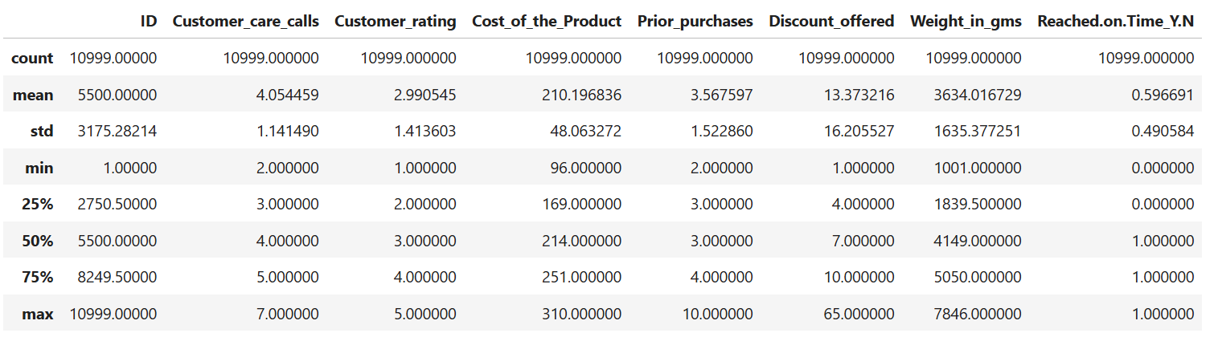
Dataset Overview
Descriptive statistics (count, mean, standard deviation, min, max, and quartiles) for variables like customer calls, product cost, prior purchases, discounts, weights, and delivery status.

Slide 12

Data Cleaning
Check for Missing Values: Ensure there are no missing values in the dataset.
Standardize Categories: Ensure categorical values (Warehouse block, Mode of Shipment, etc.) are consistent.
01
05
02
Validate Data Types: Verify that the data types align with the expected formats.
04
03
Drop unique columns: The ID column is unique for each row and does not provide meaningful information for modeling or statistical analysis.
Check for Duplicates: Identify and remove duplicate rows.

Slide 13
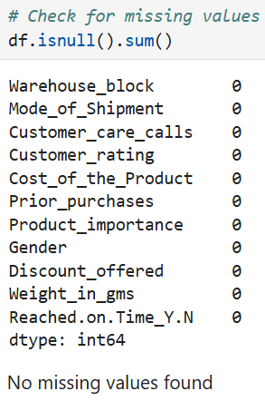
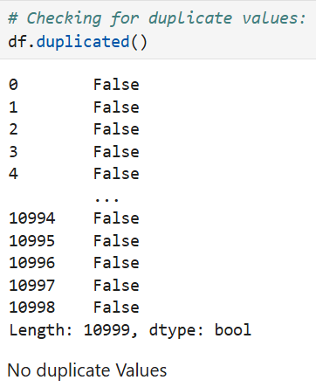
Data Cleaning

Slide 14
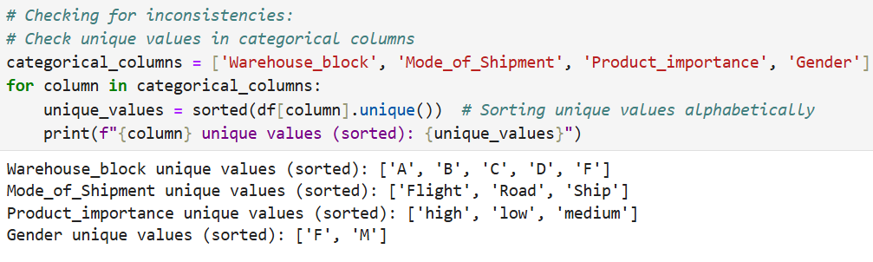
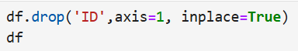
Data Cleaning

Slide 15
Exploratory Data Analysis
Pie Chart: Circular statistical graphic divided into slices to illustrate numerical proportions of a whole.
01
Heatmap :Represent data in a matrix format, where values are depicted by color intensity, making it effective for visualizing correlations or patterns in large datasets.
02
Count plot: Visualize the frequency of categories in a dataset by displaying the count of occurrences for each category as bars.
03
Histogram: Represent the distribution of numerical data by grouping it into bins and displaying the frequency of data points within each bin as bars.
04
Violin chart: Visualize the distribution of a dataset across different categories, combining features of a box plot and a kernel density plot to show data spread and density.
05

Slide 16
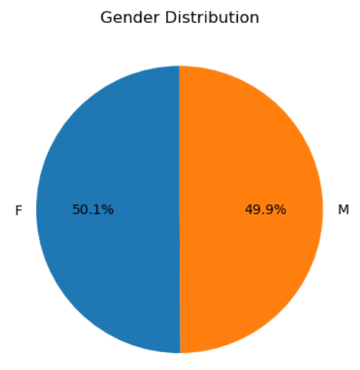
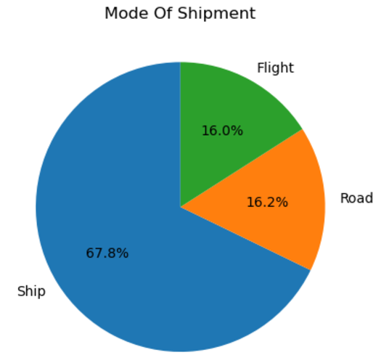
Exploratory Data Analysis
1. Pie Chart

Slide 17
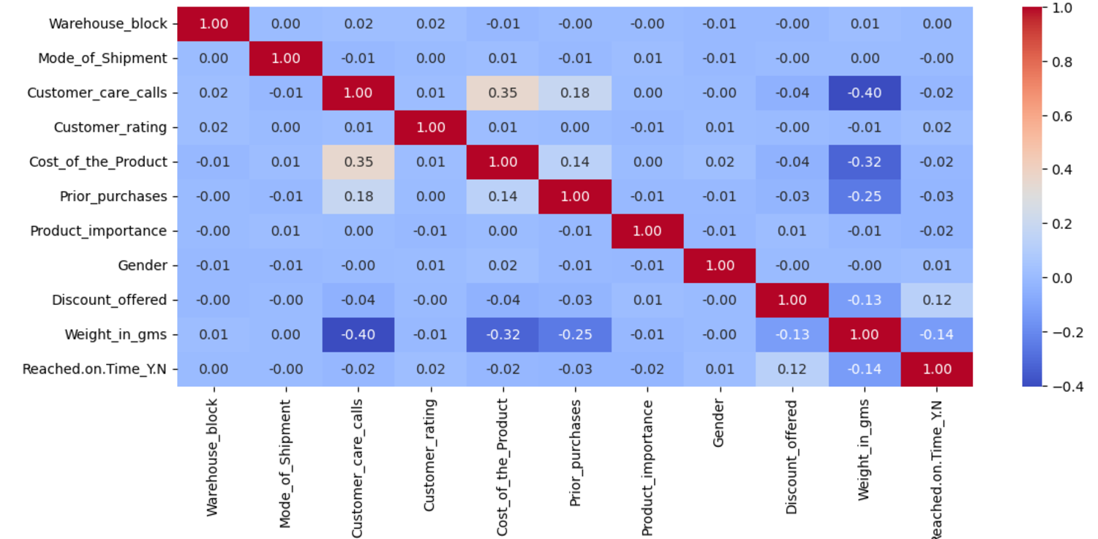
Exploratory Data Analysis
2. Heatmap:

Slide 18
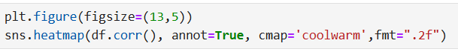
Exploratory Data Analysis
2. Heatmap:
Each variable has a perfect correlation with itself (1.0), shown by the red diagonal.
The correlation matrix heatmap shows a positive correlation between the product's cost and the number of customer care calls.
Variables like Gender, Product_importance, and Warehouse_block show weak or negligible correlation with Reached_on_Time_Y_N and other factors.
Strong negative corelation between weight of product and customer care calls

Slide 19
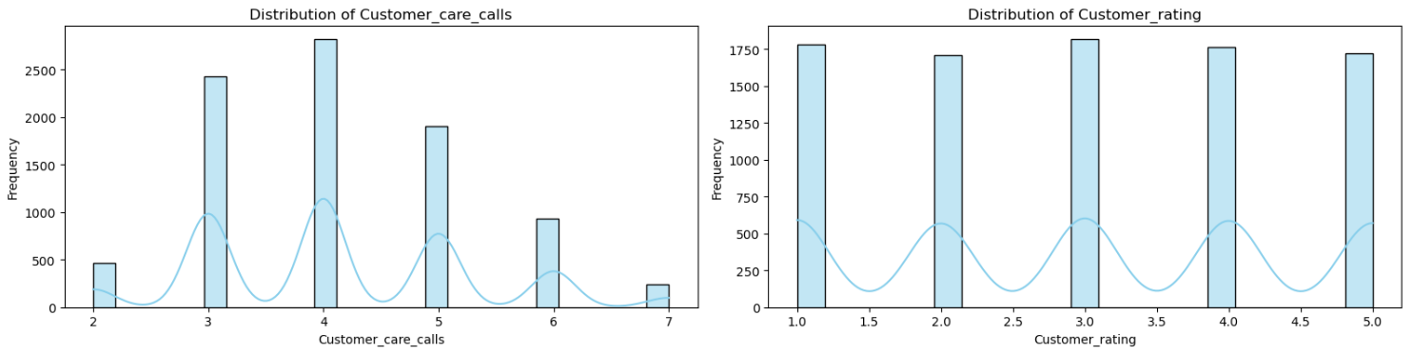
Exploratory Data Analysis
3. Histogram:
Customer Care Calls: The distribution is slightly skewed, with some customers making more calls than others.
Customer Rating: Appears evenly distributed, likely ordinal in nature.

Slide 20
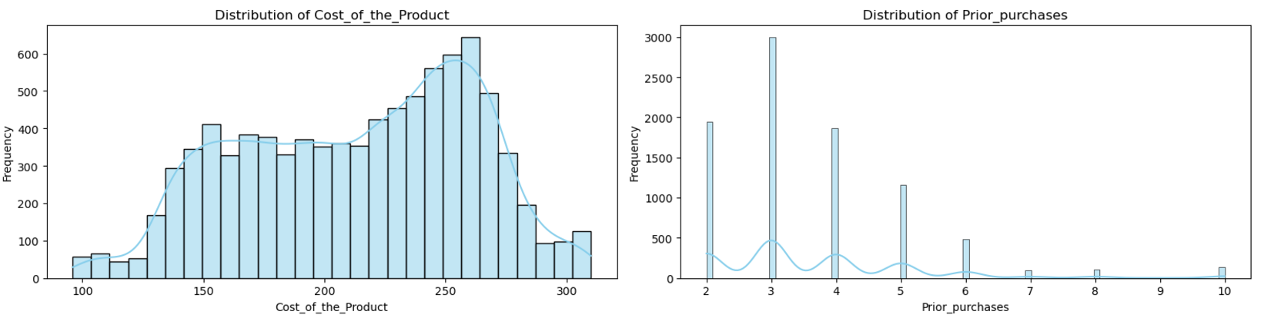
Exploratory Data Analysis
3. Histogram:
Cost of the Product: Shows a near-normal distribution centered around the midrange values.
Prior Purchases: Most customers seem to have made fewer prior purchases.

Slide 21
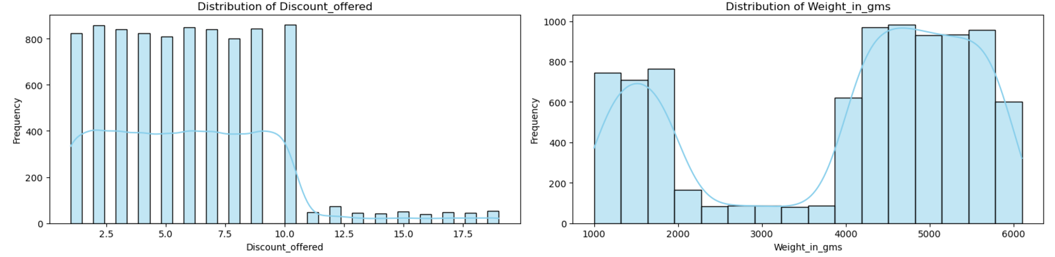
Exploratory Data Analysis
3. Histogram:
Discount Offered: Has a pronounced skew, with many cases receiving no or minimal discounts.
Weight in grams: Appears normally distributed.

Slide 22
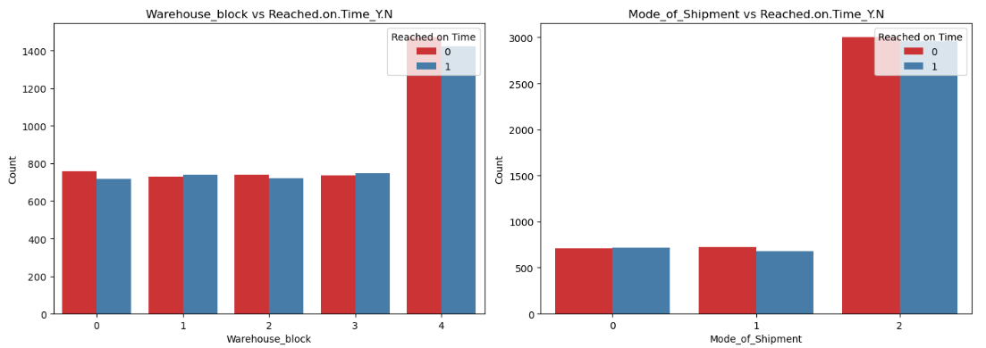
Exploratory Data Analysis
4. Count Plot
Left: Warehouse Block: Some blocks (A,B,C,D) show more delayed deliveries compared to others.
Right: Mode of Shipment: Different shipment methods have varying delay rates, with certain modes (e.g., "Flight") showing fewer delays.

Slide 23
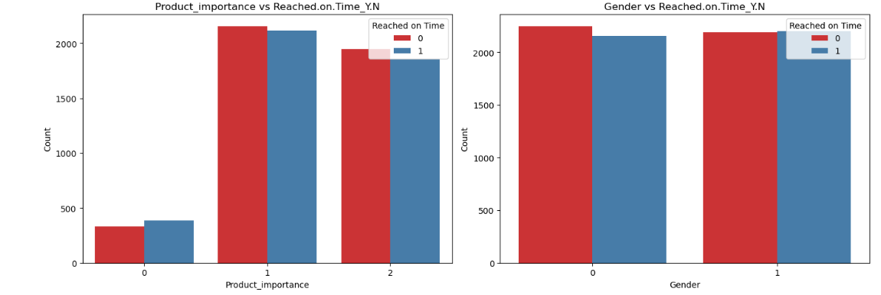
Exploratory Data Analysis
4. Count Plot
Left: Product Importance: Products marked as "low" or "medium" importance have a higher proportion of delays compared to "high."
Right: Gender: The gender of the customer does not appear to significantly influence delivery timing.

Slide 24
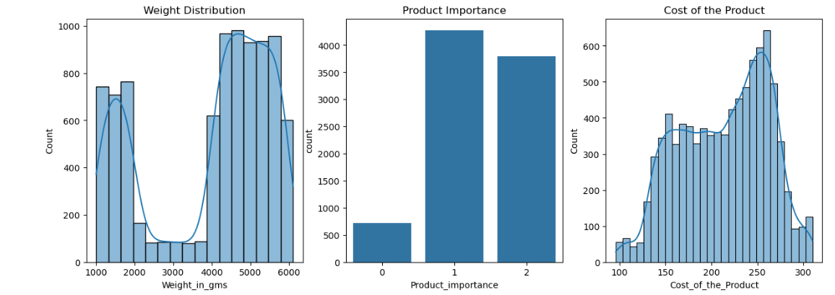
Exploratory Data Analysis
4. Count Plot
Left: Products primarily weigh between 1000-2000 grams and 4000-6000 grams
Center: Product Importance most products are categorized as having low or medium importance.
Right: Focuses on the cost distribution, highlighting a higher frequency of products priced between 150-200 and 225-275 dollars.

Slide 25
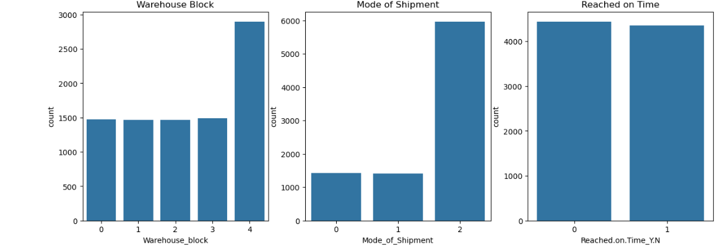
Exploratory Data Analysis
4. Count Plot
Left: Warehouse F handles the most products, around 3500, while the others don’t.
Center: Shipping methods reveal that the majority of products are transported by ship, with about 2000 products shipped via flight and road.
Right: Higher quantity of products delivered on time compared to those that are late.

Slide 26
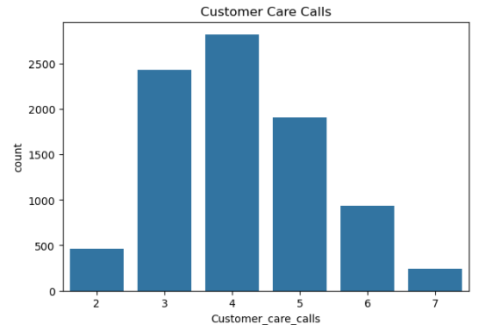
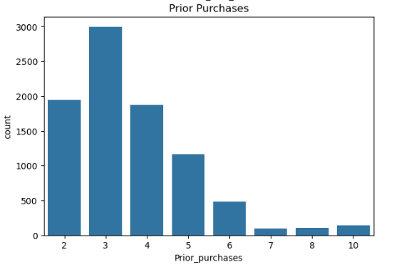
Exploratory Data Analysis
4. Count Plot
Left: Most customers make 3-4 customer care calls, suggesting possible issues with product delivery.
Right: Majority of customers have made 2-3 prior purchases, indicating that repeat customers are generally satisfied with the service and continue to engage with the company.

Slide 27
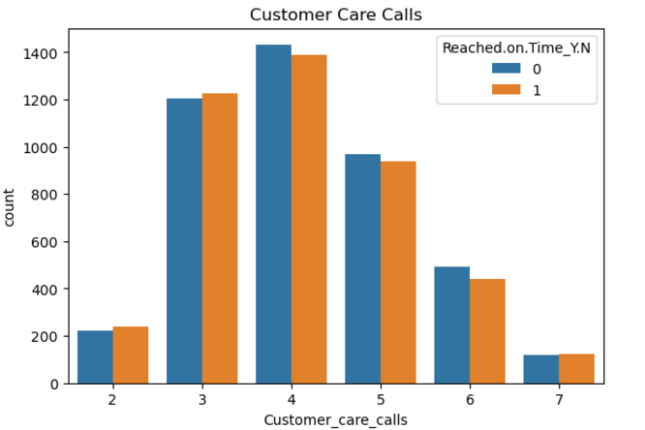
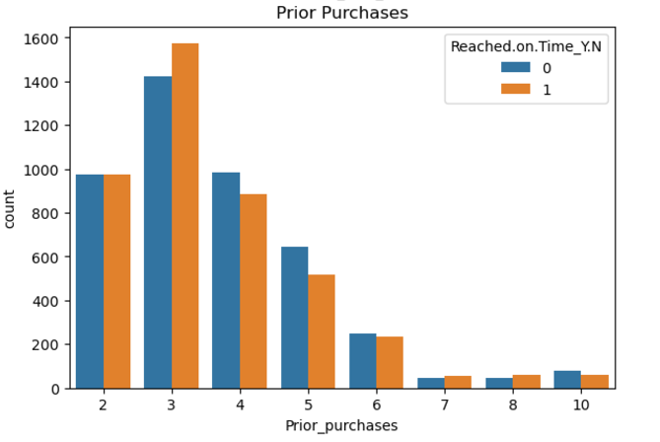
Exploratory Data Analysis
4. Count Plot
Left: customer care calls increase, on-time deliveries decrease, suggesting customers call more when deliveries are late.
Right: customers who make repeat purchases tend to receive their products on time, likely encouraging their continued business.

Slide 28
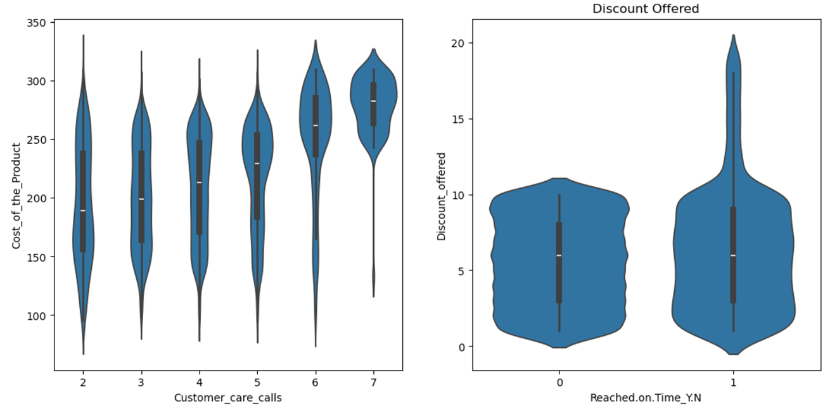
Exploratory Data Analysis
5. Violin Plot:
Left Plot: Product costs are consistent across different numbers of customer care calls.
Right Plot: Higher discounts are slightly associated with delayed deliveries.

Slide 29
Data Preprocessing
Outlier Detection
Encoding
Train Test Split
Feature Scaling
Identifies and handles data points significantly different from others.
Purpose: Prevents skewed results and improves model robustness.
Converts categorical data into numerical formats to make it usable by machine learning models.
Methods:
One-Hot Encoding
Label Encoding
Binary Encoding
Divides the dataset into training and testing subsets in 80-20 or 70-30 split
Purpose: Prevents overfitting by validating the model's performance on unseen data.
Adjusts numerical data to a uniform scale for consistency in model training.
Purpose: Ensures features with larger ranges don't dominate during model learning.

Slide 30
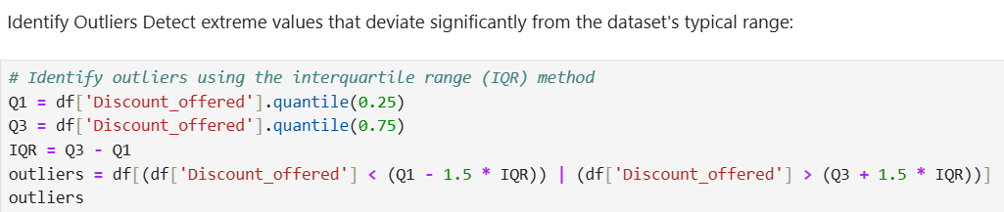
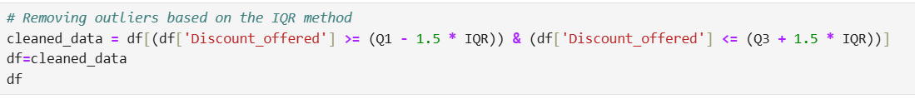
Data Preprocessing
1. Outlier Detection and Removal:

Slide 31
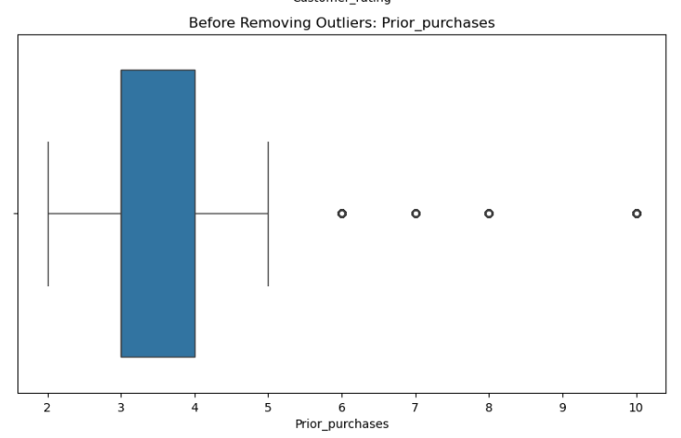
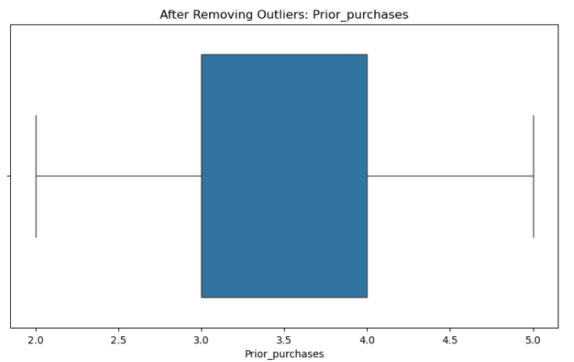
Data Preprocessing
1. Outlier Detection and Removal:

Slide 32
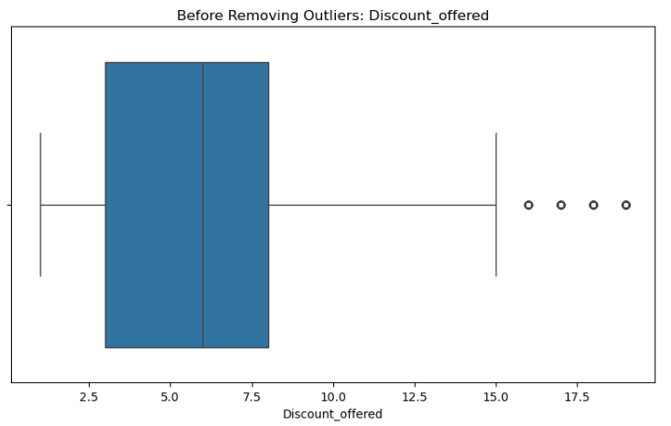
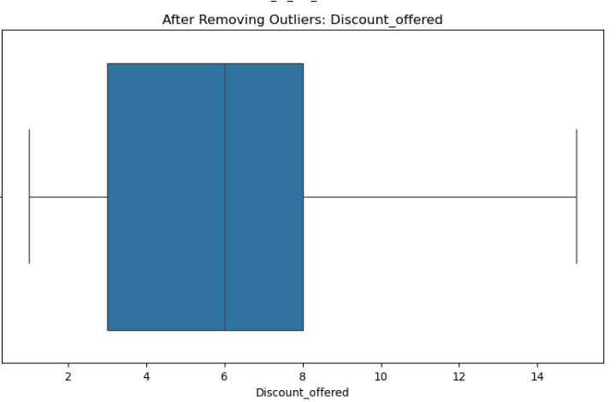
Data Preprocessing
1. Outlier Detection and Removal:

Slide 33
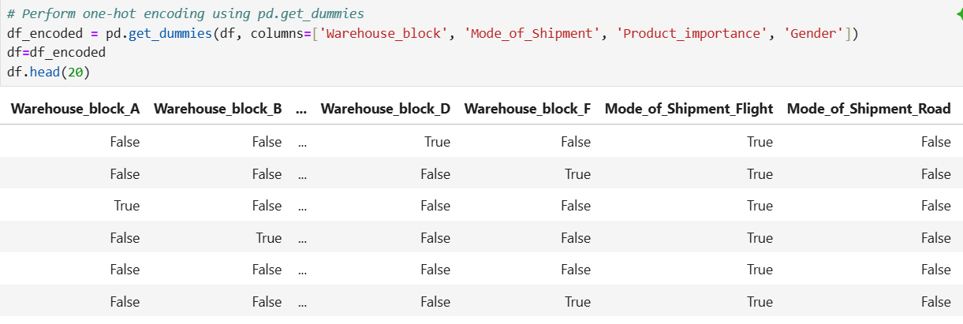
Data Preprocessing
2. Encoding: One hot encoding

Slide 34
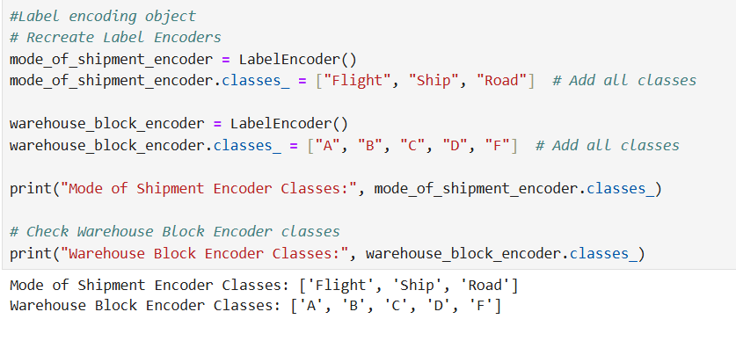
Data Preprocessing
2. Encoding: Label encoding

Slide 35
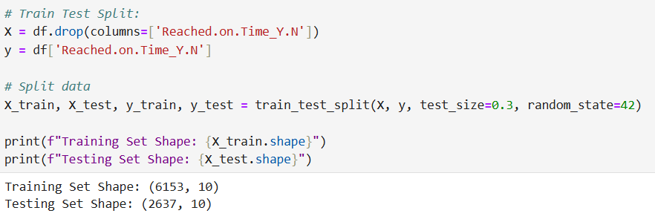
Data Preprocessing
3. Train Test Split:

Slide 36
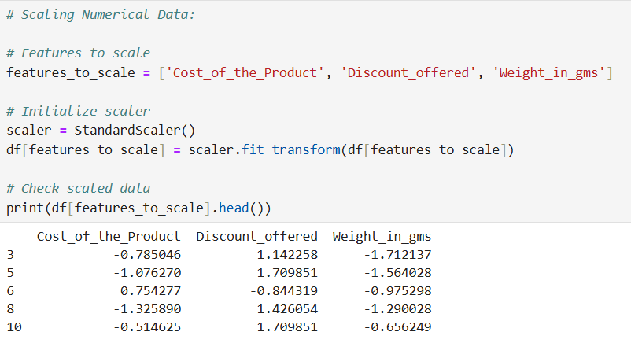
Data Preprocessing
4. Feature Scaling:

Slide 37
Model Selection
Decision Tree
02
Logistic Regression
01
A tree-like model for decision-making that splits data into branches based on feature values.
Binary classification by estimating probabilities based on linear relationships.
Random Forest
K Nearest Neighbor
03
04
An ensemble method that combines multiple decision trees to improve prediction accuracy and reduce overfitting.
Algorithm that classifies data points based on the majority class of their nearest neighbors.
XG Boost
06
05
Support Vector Machine
Gradient-boosting algorithm designed for speed and performance in supervised learning tasks.
A supervised learning model that finds the optimal hyperplane to separate data points into classes.

Slide 38
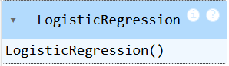
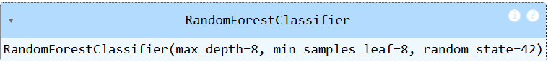
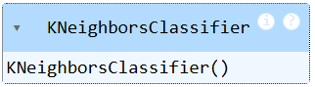
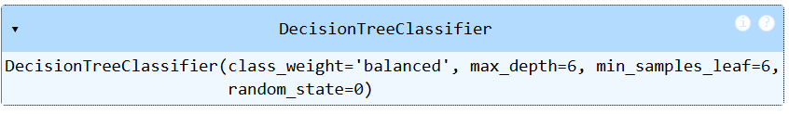
Model Selection

Slide 39
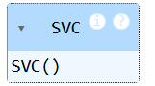
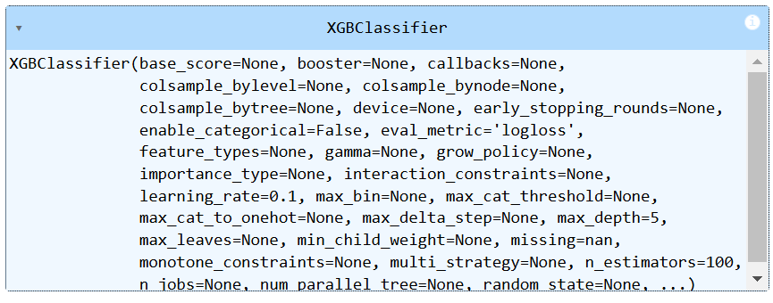
Model Selection

Slide 40
Evaluation Metrics
Accuracy: The percentage of total predictions that are correct.
Precision: When the model says "positive," how often is it right?
Recall: Out of all the actual positive cases, how many did the model catch?
F1-Score: A single score that combines both precision and recall for balance.
ROC-AUC: A score that shows how good the model is at distinguishing between positive and negative cases.
Accuracy
01
Precision
02
Recall
03
F1 Score
04
ROC-AUC
05

Slide 41
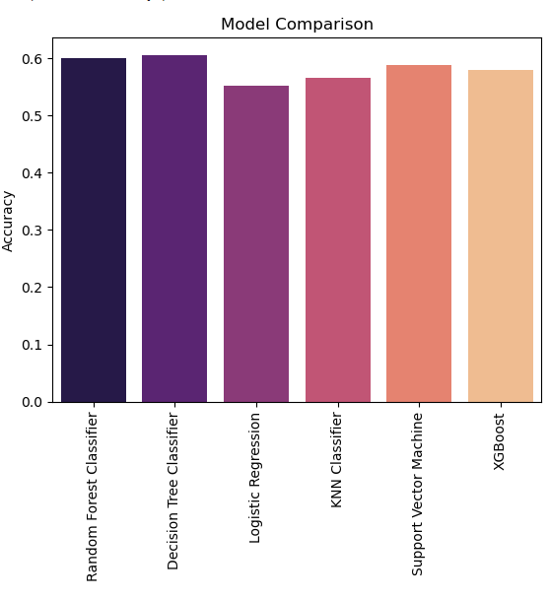
Model Comparison
Insights based on the provided bar chart:
Random Forest Classifier achieved the highest accuracy among all models.
Decision Tree Classifier performed nearly as well as Random Forest.
XGBoost , KNN, and Support Vector Machine had similar accuracy, slightly lower than Random Forest and Decision Tree.
Logistic Regression had the lowest accuracy compared to the other models.

Slide 42
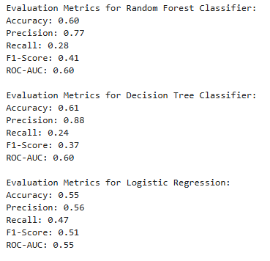
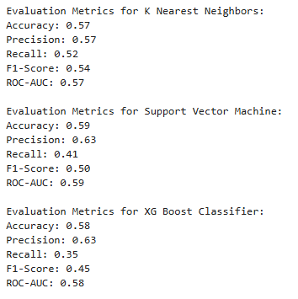
Results and Insights

Slide 43
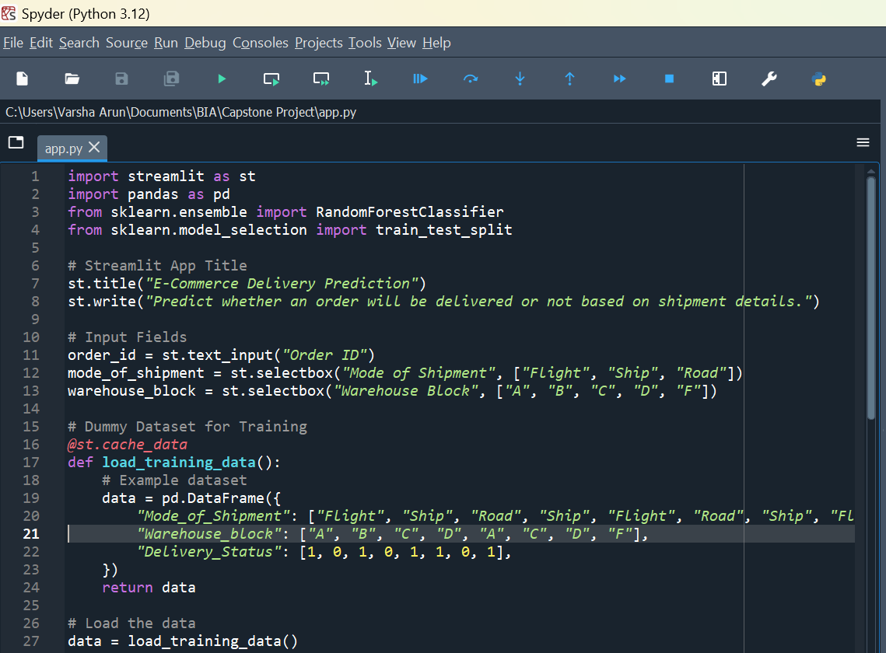
Model Deployment
Spyder IDE:
Libraries: Supports NumPy, Pandas, Matplotlib, SciPy.
Interface: Customizable with editor, console, explorer.
Platform: Available on Windows, macOS, Linux.
Distribution: Often included with Anaconda.
Debugging: Built-in tools for debugging code.

Slide 44
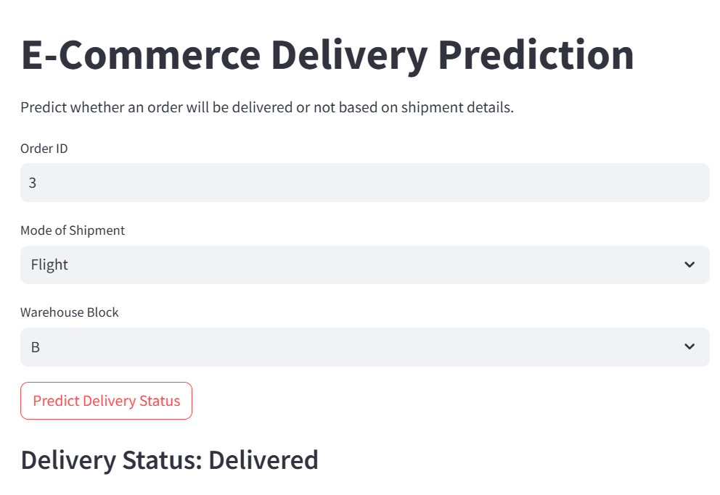
User Interface

Slide 45
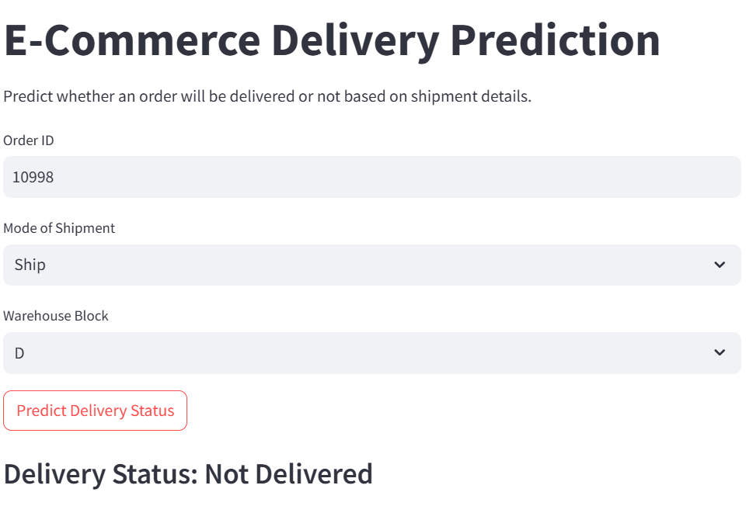
User Interface

Slide 46
Conclusion
The project successfully developed a predictive model to determine e-commerce delivery status based on shipment details. This foundation opens opportunities for further enhancements, such as predicting delivery delays or optimizing operational efficiency.
Objective Achieved: Successfully predicted delivery status using shipment details.
Model Performance: Evaluated multiple models for accuracy and reliability.
User Interface: Developed an interactive UI for easy prediction.
Business Impact: Facilitates better logistics planning and customer satisfaction.
Future Scope: Can integrate additional factors for improved predictions.

Slide 47
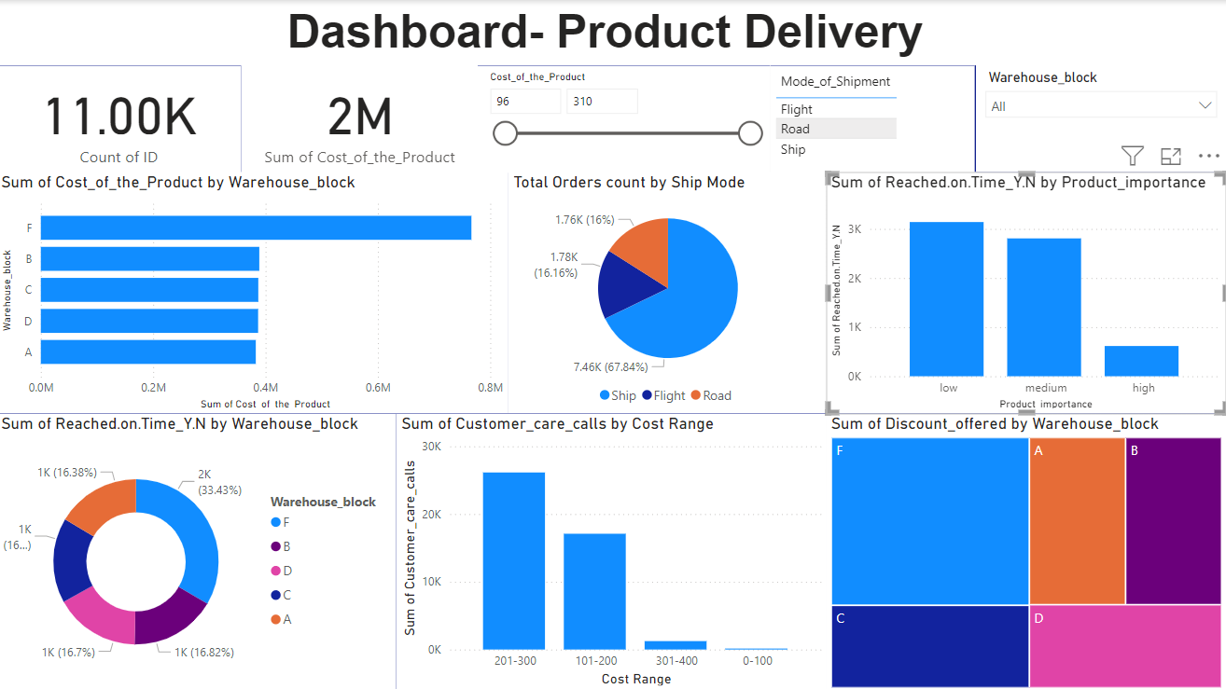
Power BI Dashboard

Slide 48
Questions ?

Slide 49
Thank You!

